Slide 1
Data Mining
Lecture 7

Slide 2
Course Syllabus
Clustering Techniques (Week 6)
  K-Means Clustering
  Other Clustering Techniques

Slide 3
Clustering

Slide 4
What is Cluster Analysis?
Cluster: a collection of data objects
  Similar to one another within the same cluster
  Dissimilar to the objects in other clusters
Cluster analysis
  Finding similarities between data according to the characteristics found in the data and grouping similar data objects into clusters
Unsupervised learning: no predefined classes
Typical applications
  As a stand-alone tool to get insight into data distribution
  As a preprocessing step for other algorithms

Slide 5
Examples of Clustering Applications
Marketing: Help marketers discover distinct groups in their customer bases, and then use this knowledge to develop targeted marketing programs
Land use: Identification of areas of similar land use in an earth observation database
Insurance: Identifying groups of motor insurance policy holders with a high average claim cost
City-planning: Identifying groups of houses according to their house type, value, and geographical location
Earth-quake studies: Observed earth quake epicenters should be clustered along continent faults

Slide 6
Requirements of Clustering in Data Mining
Scalability
Ability to deal with different types of attributes
Ability to handle dynamic data
Discovery of clusters with arbitrary shape
Minimal requirements for domain knowledge to determine input parameters
Able to deal with noise and outliers
Insensitive to order of input records
High dimensionality
Incorporation of user-specified constraints
Interpretability and usability

Slide 7
Quality: What Is Good Clustering?
A good clustering method will produce high quality clusters with
  high intra-class similarity
  low inter-class similarity
The quality of a clustering result depends on both the similarity measure used by the method and its implementation
The quality of a clustering method is also measured by its ability to discover some or all of the hidden patterns

Slide 8
Clustering
We should care about similarity/distance model for
  Intra Cluster Similarity
  Inter Cluster Similarity
But these metrics highly subject oriented, variable type oriented

Slide 9
Measure the Quality of Clustering
Dissimilarity/Similarity metric: Similarity is expressed in terms of a distance function, typically metric: d(i, j)
There is a separate “quality” function that measures the “goodness” of a cluster.
The definitions of distance functions are usually very different for interval-scaled, boolean, categorical, ordinal ratio, and vector variables.
Weights should be associated with different variables based on applications and data semantics.
It is hard to define “similar enough” or “good enough”
  the answer is typically highly subjective.

Slide 10
Type of data in clustering analysis
Interval-scaled variables
Binary variables
Nominal, ordinal, and ratio variables
Variables of mixed types

Slide 11


Data Structures
Data matrix
  (two modes)
Dissimilarity matrix
  (one mode)

Slide 12


Interval-valued variables
Standardize data
  Calculate the mean absolute deviation:
  where
  Calculate the standardized measurement (z-score)
Using mean absolute deviation is more robust than using standard deviation

Slide 13


Similarity and Dissimilarity Between Objects
Distances are normally used to measure the similarity or dissimilarity between two data objects
Some popular ones include: Minkowski distance:
  where i = (xi1, xi2, …, xip) and j = (xj1, xj2, …, xjp) are two p-dimensional data objects, and q is a positive integer
If q = 1, d is Manhattan distance

Slide 14

Similarity and Dissimilarity Between Objects (Cont.)
If q = 2, d is Euclidean distance:
  Properties
    d(i,j) ≥ 0
    d(i,i) = 0
    d(i,j) = d(j,i)
    d(i,j) ≤ d(i,k) + d(k,j)
Also, one can use weighted distance, parametric Pearson product moment correlation, or other disimilarity measures

Slide 15


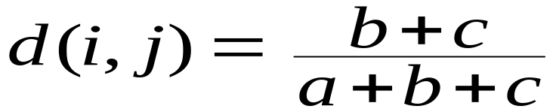
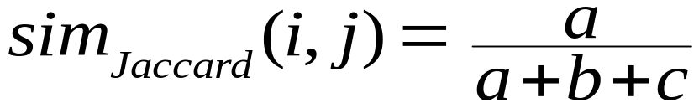
Binary Variables
Object j
A contingency table for binary data
Distance measure for symmetric binary variables:
Distance measure for asymmetric binary variables:
Jaccard coefficient (similarity measure for asymmetric binary variables):
Object i

Slide 16

Nominal Variables
A generalization of the binary variable in that it can take more than 2 states, e.g., red, yellow, blue, green
Method 1: Simple matching
  m: # of matches, p: total # of variables
Method 2: use a large number of binary variables
  creating a new binary variable for each of the M nominal states

Slide 17


Ordinal Variables
An ordinal variable can be discrete or continuous
Order is important, e.g., rank
Can be treated like interval-scaled
  replace xif by their rank
  map the range of each variable onto [0, 1] by replacing i-th object in the f-th variable by
  compute the dissimilarity using methods for interval-scaled variables

Slide 18
Ratio-Scaled Variables
Ratio-scaled variable: a positive measurement on a nonlinear scale, approximately at exponential scale, such as AeBt or Ae-Bt
Methods:
  treat them like interval-scaled variables—not a good choice! (why?—the scale can be distorted)
  apply logarithmic transformation
yif = log(xif)
  treat them as continuous ordinal data treat their rank as interval-scaled

Slide 19


Variables of Mixed Types
A database may contain all the six types of variables
  symmetric binary, asymmetric binary, nominal, ordinal, interval and ratio
One may use a weighted formula to combine their effects
  f is binary or nominal:
    d_{ij}^{(f)} = 0 if x_{if} = x_{jf} , or d_{ij}^{(f)} = 1 otherwise
  f is interval-based: use the normalized distance
  f is ordinal or ratio-scaled
    compute ranks r_{if} and
    and treat z_{if} as interval-scaled

Slide 20


Vector Objects
Vector objects: keywords in documents, gene features in micro-arrays, etc.
Broad applications: information retrieval, biologic taxonomy, etc.
Cosine measure
A variant: Tanimoto coefficient

Slide 21
Typical Alternatives to Calculate the Distance between Clusters (Inter Cluster Distance)
Single link: smallest distance between an element in one cluster and an element in the other, i.e., dis(Ki, Kj) = min(tip, tjq)
Complete link: largest distance between an element in one cluster and an element in the other, i.e., dis(Ki, Kj) = max(tip, tjq)
Average: avg distance between an element in one cluster and an element in the other, i.e., dis(Ki, Kj) = avg(tip, tjq)
Centroid: distance between the centroids of two clusters, i.e., dis(Ki, Kj) = dis(Ci, Cj)
Medoid: distance between the medoids of two clusters, i.e., dis(Ki, Kj) = dis(Mi, Mj)
  Medoid: one chosen, centrally located object in the cluster

Slide 22
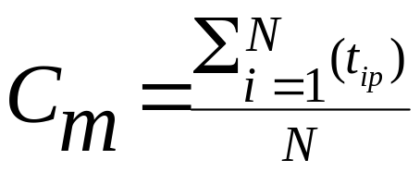
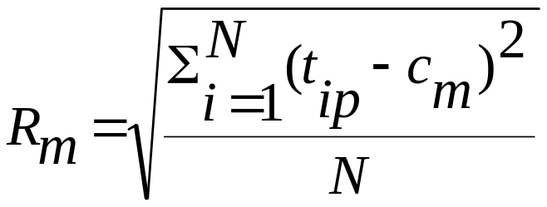

Centroid, Radius and Diameter of a Cluster (for numerical data sets)
Centroid: the “middle” of a cluster
Radius: square root of average distance from any point of the cluster to its centroid
Diameter: square root of average mean squared distance between all pairs of points in the cluster

Slide 23
Major Clustering Approaches (I)
Partitioning approach:
  Construct various partitions and then evaluate them by some criterion, e.g., minimizing the sum of square errors
  Typical methods: k-means, k-medoids, CLARANS
Hierarchical approach:
  Create a hierarchical decomposition of the set of data (or objects) using some criterion
  Typical methods: Diana, Agnes, BIRCH, ROCK, CAMELEON
Density-based approach:
  Based on connectivity and density functions
  Typical methods: DBSCAN, OPTICS, DenClue

Slide 24
Major Clustering Approaches (II)
Grid-based approach:
  based on a multiple-level granularity structure
  Typical methods: STING, WaveCluster, CLIQUE
Model-based:
  A model is hypothesized for each of the clusters and tries to find the best fit of that model to each other
  Typical methods: EM, SOM, COBWEB
Frequent pattern-based:
  Based on the analysis of frequent patterns
  Typical methods: pCluster
User-guided or constraint-based:
  Clustering by considering user-specified or application-specific constraints
  Typical methods: COD (obstacles), constrained clustering

Slide 25
K-Means Clustering In Details
Given k, the k-means algorithm is implemented in four steps:
  Partition objects into k nonempty subsets
  Compute seed points as the centroids of the clusters of the current partition (the centroid is the center, i.e., mean point, of the cluster)
  Assign each object to the cluster with the nearest seed point
  Go back to Step 2, stop when no more new assignment

Slide 26
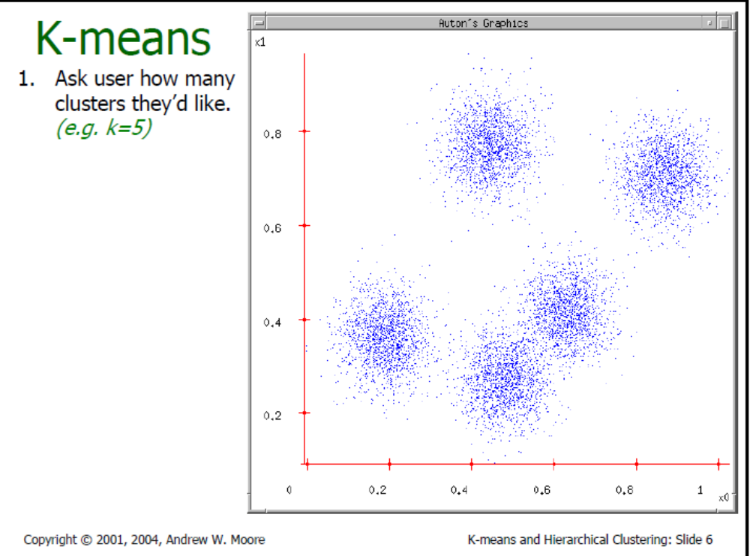

Slide 27
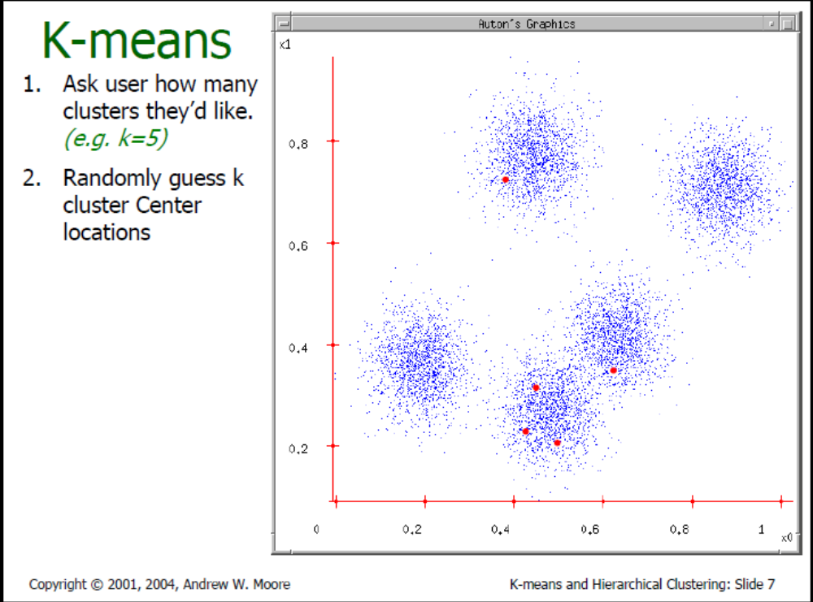

Slide 28
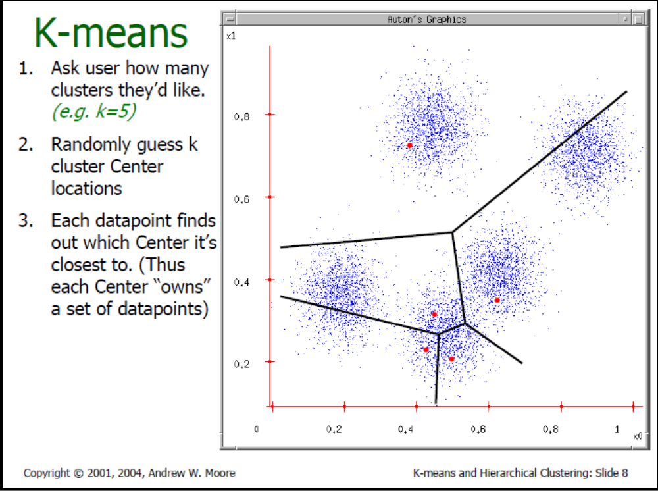
Voronoi Diagram

Slide 29
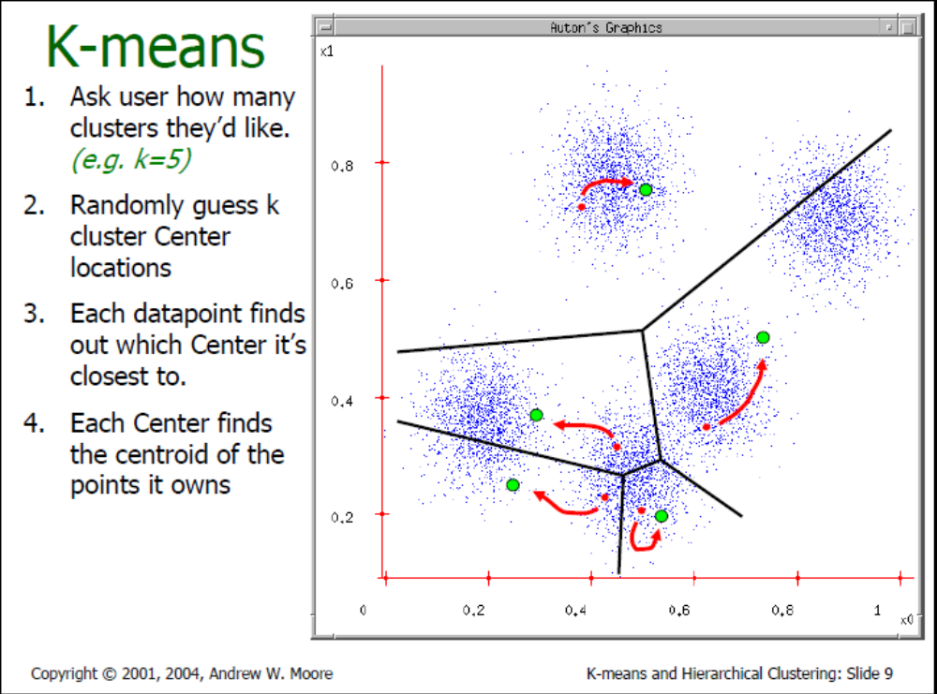

Slide 30
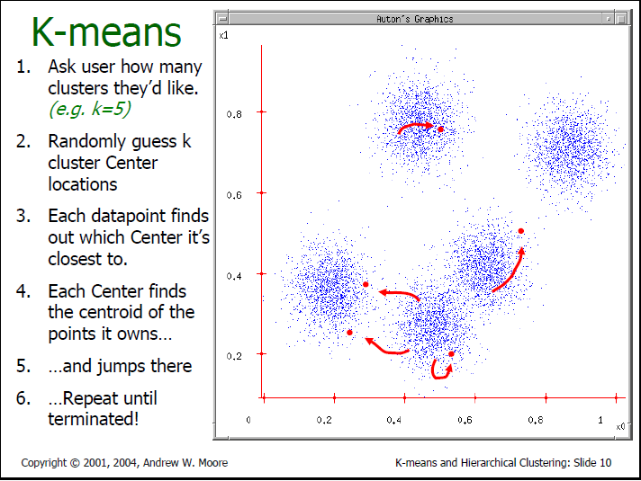

Slide 31



The K-Means Clustering Method
Example
10
10
9
9
8
8
7
7
6
6
5
5
4
Assign each objects to most similar center
Update the cluster means
4
3
3
2
2
1
1
0
0
0
1
2
3
4
5
6
7
8
9
10
0
1
2
3
4
5
6
7
8
9
10
reassign
reassign
K=2
Arbitrarily choose K object as initial cluster center
Update the cluster means

Slide 32
Comments on the K-Means Method
Strength: Relatively efficient: O(tkn), where n is # objects, k is # clusters, and t is # iterations. Normally, k, t << n.
    Comparing: PAM: O(k(n-k)2 ), CLARA: O(ks2 + k(n-k))
Comment: Often terminates at a local optimum. The global optimum may be found using techniques such as: deterministic annealing and genetic algorithms
Weakness
  Applicable only when mean is defined, then what about categorical data?
  Need to specify k, the number of clusters, in advance
  Unable to handle noisy data and outliers
  Not suitable to discover clusters with non-convex shapes

Slide 33
Medoid Clustering
Medoid Clustering is more robust than k-means in the presence of noise and outliers because a medoid is less influenced by outliers or other extreme values than a mean
Medoid Clustering works efficiently for small data sets but does not scale well for large data sets.
  O(k(n-k)² ) for each iteration
where n is # of data,k is # of clusters

Slide 34
Hierarchical Clustering
Use distance matrix as clustering criteria. This method does not require the number of clusters k as an input, but needs a termination condition
Step 0
Step 1
Step 2
Step 3
Step 4
agglomerative
(AGNES)
a
a b
b
a b c d e
c
c d e
d
d e
e
divisive
(DIANA)
Step 4
Step 3
Step 2
Step 1
Step 0

Slide 35

AGNES (Agglomerative Nesting)
Introduced in Kaufmann and Rousseeuw (1990)
Implemented in statistical analysis packages, e.g., Splus
Use the Single-Link method and the dissimilarity matrix.
Merge nodes that have the least dissimilarity
Go on in a non-descending fashion
Eventually all nodes belong to the same cluster

Slide 36
Dendrogram: Shows How the Clusters are Merged
  Decompose data objects into a several levels of nested partitioning (tree of clusters), called a dendrogram.
  A clustering of the data objects is obtained by cutting the dendrogram at the desired level, then each connected component forms a cluster.

Slide 37
DIANA (Divisive Analysis)
Introduced in Kaufmann and Rousseeuw (1990)
Implemented in statistical analysis packages, e.g., Splus
Inverse order of AGNES
Eventually each node forms a cluster on its own

Slide 38
Recent Hierarchical Clustering Methods
Major weakness of agglomerative clustering methods
  do not scale well: time complexity of at least O(n²), where n is the number of total objects
  can never undo what was done previously
Integration of hierarchical with distance-based clustering
  BIRCH (1996): uses CF-tree and incrementally adjusts the quality of sub-clusters
  ROCK (1999): clustering categorical data by neighbor and link analysis
  CHAMELEON (1999): hierarchical clustering using dynamic modeling

Slide 39
Week 7-End
assignment 3 (please share your ideas with your group)
  choose freely a dataset my advice: http://www.inf.ed.ac.uk/teaching/courses/dme/html/datasets0405.html
  use Weka
  http://www.cs.waikato.ac.nz/ml/weka/
  - apply K-Means Clustering Algorithm with different settings (different K, different similarity function,...), measure the quality of the results) and bring the outputs of your analysis for the next week

Slide 40
Week 7-End
read
  Course Text Book Chapter 7

